Slide 1
Moving From Natural Numbers to Signed Numbers
Presented at V²CTM

Slide 2
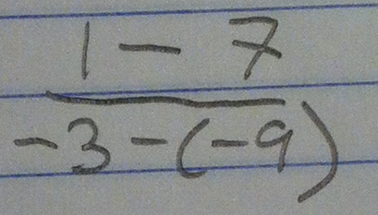
What math problem do you think this student is answering?

Slide 3
Graph the line the student was working with.

Slide 4
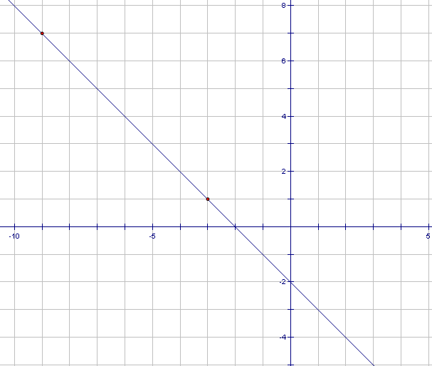
(–9,⁺7)
(–3,⁺1)
Did your graph look something like this?

Slide 5
Where do the different parts of this expression show up on your graph?

Slide 6
(–9,⁺7)
(–3,⁺1)
Where can students “see” the differences?

Slide 7
(–9,⁺7)
1 – 7
(–3,⁺1)

Slide 8
(–9,⁺7)
1 – 7
– 3 – –9
(–3,⁺1)
What question are the differences, –6 and ⁺6, answering?

Slide 9
(–9,⁺7)
1 – 7
– 3 – –9
(–3,⁺1)
What would happen if the student was starting with (–3,⁺1)?

Slide 10
(–9,⁺7)
(–3,⁺1)
What would happen if the student was starting with (–3,⁺1)?

Slide 11
(–9,⁺7)
– 9 – –3
1 – 7
7 – 1
– 3 – –9
(–3,⁺1)
What would happen if the student was starting with (–3,⁺1)?

Slide 12
How do we usually tell students to think about – 3 – –9?

Slide 13
But – 3 + 9 doesn’t show up anywhere on the graph!
+9 doesn’t even show up!
Now the student has trouble making sense of the slope formula…

Slide 14
Moving towards algebra, there are TWO new ways our students need to think:
We can work with negative numbers.
Subtraction can be a directed difference.

Slide 15
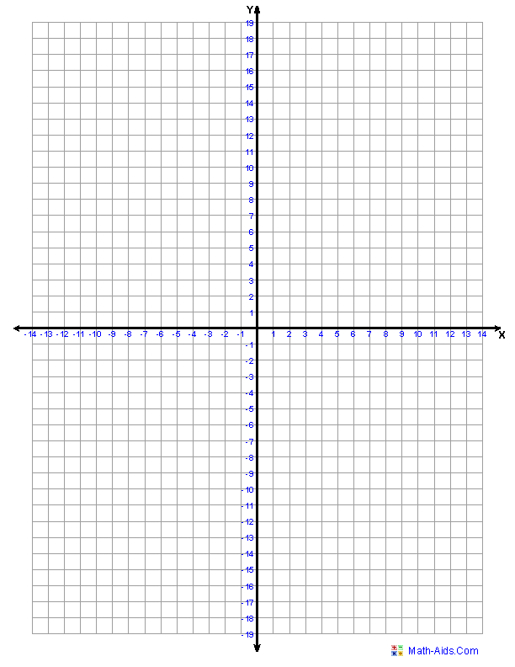

Slide 16
Working with the counters as counting numbers.
7 + 3 7 – 3
What would addition mean?
What would the opposite of addition be?
What would directed difference mean?

Slide 17
Think of two story problems for
12 – 8
One that uses take-away subtraction
One that uses a directed difference

Slide 18
Two-Color Counters as Signed Numbers
What represents a positive number?
What represents a negative number?
What represents addition?
–5 + –10 ⁺3 + ⁺6 –11 + ⁺2

Slide 19
Two-Color Counters as Signed Numbers
What represents a positive number?
Yellow counters
What represents a negative number?
What represents addition?
–5 + –10 ⁺3 + ⁺6 –11 + ⁺2

Slide 20
Two-Color Counters as Signed Numbers
What represents a positive number?
Yellow counters
What represents a negative number?
Red counters
What represents addition?
–5 + –10 ⁺3 + ⁺6 –11 + ⁺2

Slide 21
Two-Color Counters as Signed Numbers
What represents a positive number?
Yellow counters
What represents a negative number?
Red counters
What represents addition?
Adding more counters
–5 + –10 ⁺3 + ⁺6 –11 + ⁺2

Slide 22
Two-Color Counters as Signed Numbers
What would the opposite of addition be?
–5 – –10
⁺3 – ⁺6
⁺11 – ⁺2
–4 – ⁺9

Slide 23
Two-Color Counters as Signed Numbers
What would the opposite of addition be?
Taking away counters
–5 – –10
⁺3 – ⁺6
⁺11 – ⁺2
–4 – ⁺9

Slide 24
Two-Color Counters as Signed Numbers
What would a directed difference be?
How to get from the second number to the first
–5 – –10
⁺3 – ⁺6
⁺11 – ⁺2
–4 – ⁺9

Slide 25
Number Line Trips as Signed Numbers
What would a positive number represent?
What would a negative number represent?
What would addition represent?
–5 + –10 ⁺3 + ⁺6 –11 + ⁺2

Slide 26
Number Line Trips as Signed Numbers
What would a positive number represent?
A trip to the right
What would a negative number represent?
What would addition represent?
–5 + –10 ⁺3 + ⁺6 –11 + ⁺2

Slide 27
Number Line Trips as Signed Numbers
What would a positive number represent?
A trip to the right
What would a negative number represent?
A trip to the left
What would addition represent?
–5 + –10 ⁺3 + ⁺6 –11 + ⁺2

Slide 28
Number Line Trips as Signed Numbers
What would a positive number represent?
A trip to the right
What would a negative number represent?
A trip to the left
What would addition represent?
Continuing on to another trip (head-to-tail)
–5 + –10 ⁺3 + ⁺6 –11 + ⁺2

Slide 29
Number Line Trips as Signed Numbers
What would be the opposite of addition?
“Undoing” the next trip (head-to-head)
What would a directed difference be?
Getting from the end of second trip to the first
–5 – –10 ⁺3 – ⁺6 ⁺11 – ⁺2

Slide 30
REMEMBER…
Moving towards algebra, there are TWO new ways our students need to think:
We can work with negative numbers.
Subtraction can be a directed difference.

Slide 31
Thank you!!
Please contact me with any questions:
Katy Ulrich
culrich@vt.edu

